Slide 1

Presented by 李昀哲 赵晨羽

Slide 2



Slide 3
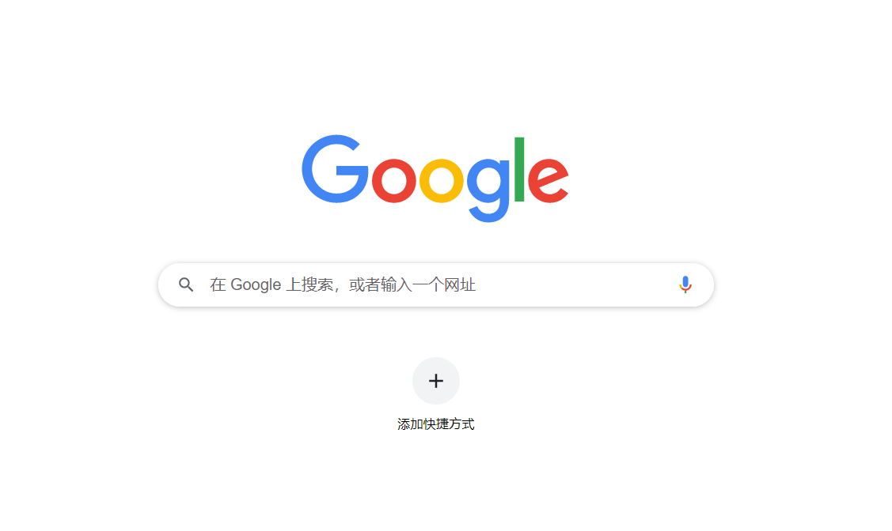

Slide 4
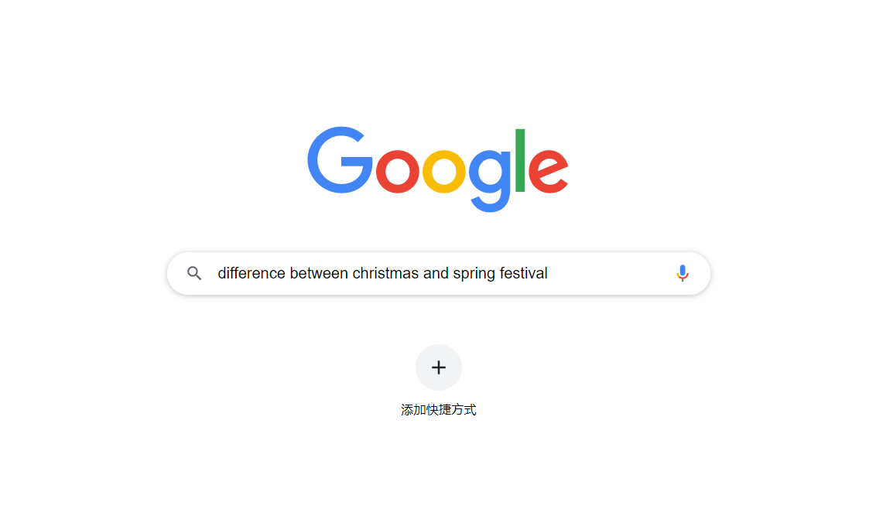

Slide 5


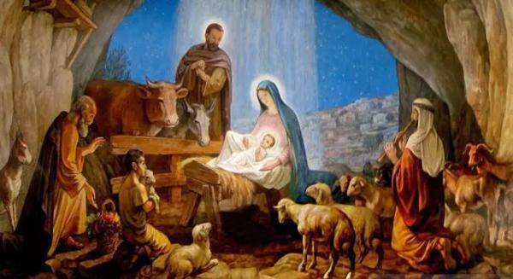

Slide 6



Slide 7


Slide 8


Study Report
Salary
Housing
Car

Slide 9



Slide 10

With yourself
With your friends
With your lover

Slide 11



